Slide 1
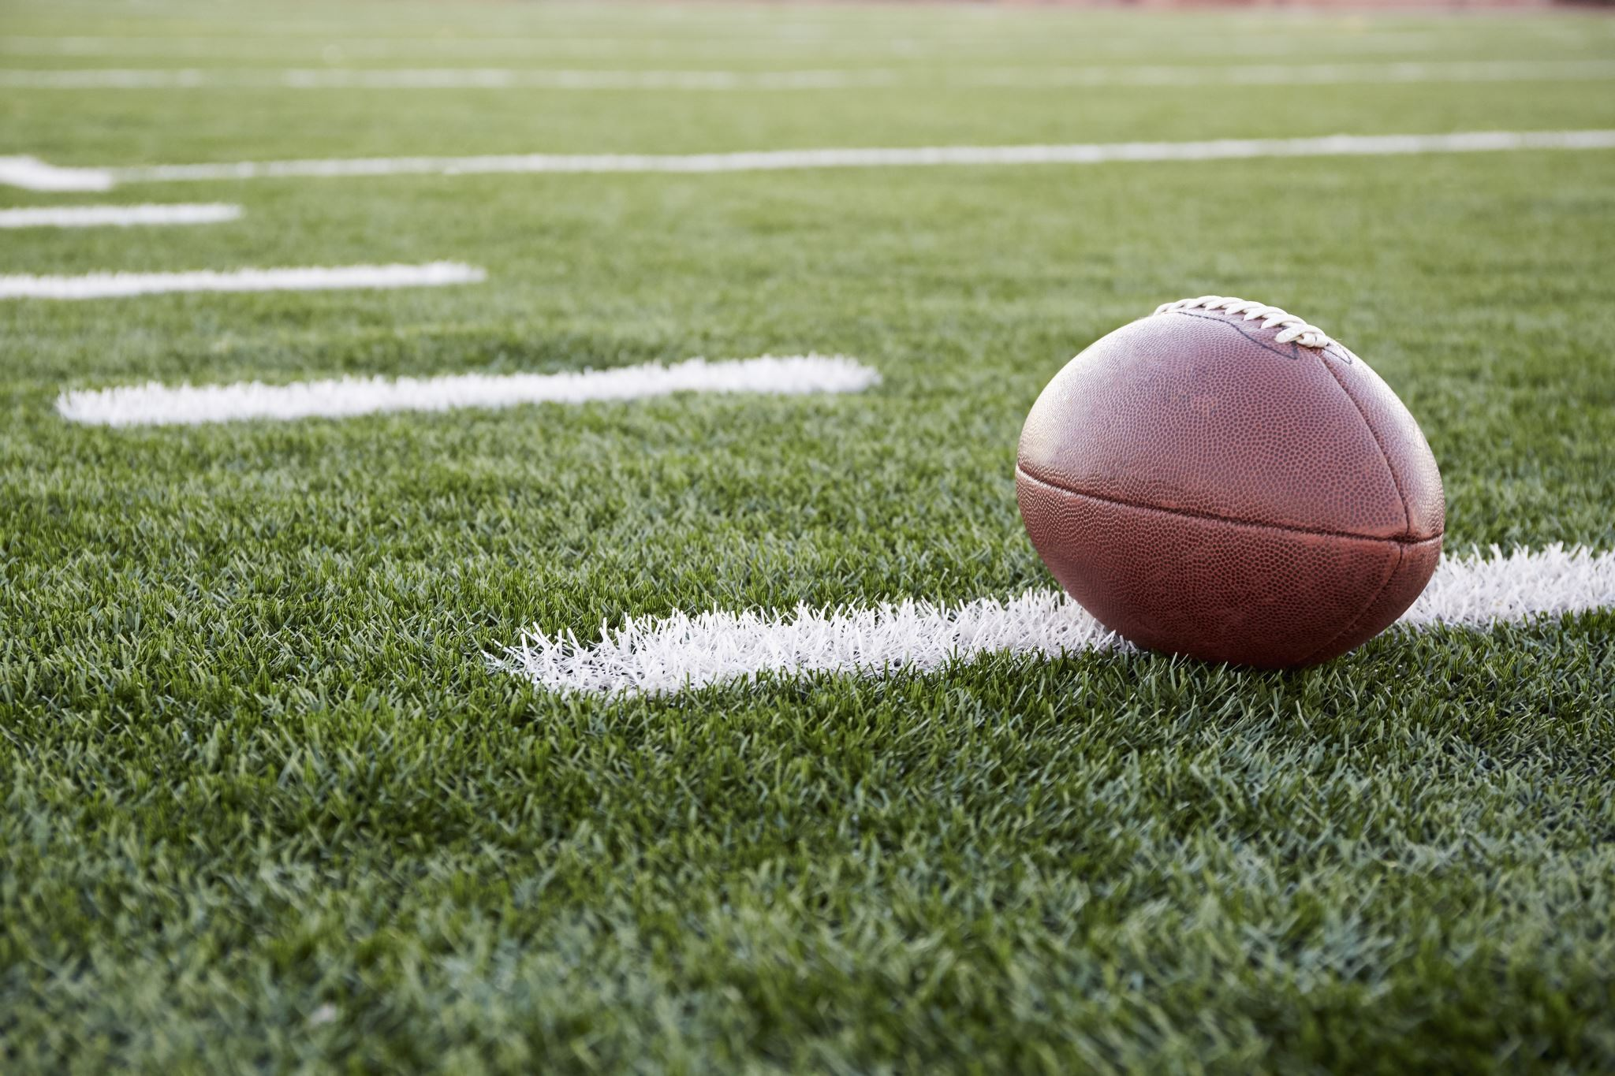
Tom Brady: The Most Overrated Athlete of All Time
Jarrett Markman

Slide 2

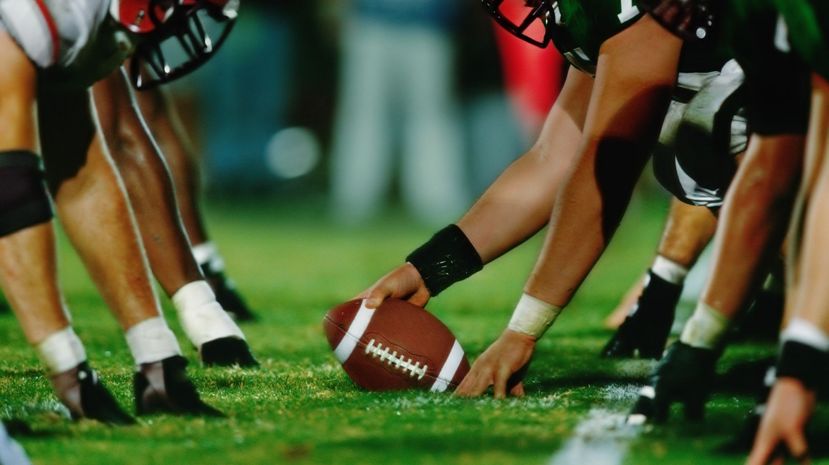
Quote from Cris Collinsworth
”The Rams have the better team, but the Bucs have Tom Brady.”
Collinsworth went on to say that the game would be close because of Tom Brady. However, for the game to be a lot closer, the defense would need to prevent the Rams from scoring, something Tom Brady has no control of.

Slide 3

PSA
z
THE SUPER BOWL IS A TEAM AWARD, yes QB is important, but football is the epitome of a team sport and is a team award. As seen in a paper written by Steven Vu given positional correlation coefficients QB isn’t as valuable as people make it out to be. Tom Brady should not be the sole benefactor of the Patriots success and their 6 wins. There are hundreds of other players that played a big role in their success. Like, Randy Moss, Rob Gronkowski, Devin White, Mike Evans, Chris Godwin, Tristan Wirfs, Shaq Barrett, Rob Ninkovich, Wes Welker, Julian Edelman, James White, Dion Lewis, Stephon Gilmore. The names are countless, and I could probably produce at least 100 household names that Tom Brady played with and won a super bowl with. The amount of rings a player has should not be what defines them as the “greatest.” The only argument for Tom Brady being the GOAT is his rings. He’s not the best quarterback based on any measure of statistics. He shouldn’t be called “the best” if the only argument for him is a team accomplishment instead of his own statistics or accomplishments. While it is impossible to say whether he would find success on other teams or if other quarterbacks would maintain the same level of success. It is clear based on data that other quarterbacks perform better than him and have much more of an impact on how well the team performs instead of Tom Brady exploiting his team’s success. He does not become better in the playoffs as silly people believe for some reason. Tom Brady plays quarterback in the National Football league. He does not play cornerback, or wide receiver, or defensive end or special teams. His team impact comes from his role as the quarterback, not as another offensive player or as a defensive player or as a special teams player. Hypothetically, Brady could throw an interception every single time he has a pass attempt, yet his team could still win the game, or even blow out the opponent if the other 52 players on the team play their role and find their own success.

Slide 4
EPA/play
EPA/play is a statistic that measures the value of individual plays based on game situation. It’s done by calculating the expected points based on the down, distance and field position at the beginning of a play in contrast to its result. Basically, a point estimation for the points added for a 1st and 10, and if for instance, the quarterback gets sacked for a 10-yard loss, the points added from that play would be negative, lowering the overall EPA. However, if there was a pass for 20 yards and a first down that low expected points added value would increase. This can be seen in an example from Super Bowl XLIII, “After an interception, the Arizona Cardinals take over on the 34 of the Pittsburgh Steelers. They start the drive with a 3.31 EPA, which makes sense, as they are already in field goal range. Two incompletions lower that to 2.08, before a 3rd-and-10 conversion to Tim Hightower raises the EP to 3.97, an EPA of 1.89.” The 3rd down conversion play is valued at 1.89 because that is how many expected points that one play added to the previous estimation.

Slide 5
CPOE
CPOE is an advanced metric to measure QB performance. There is a calculation of the probability a pass will be completed using different variables such as field position, down and distance, era and air distance to name a few. That expected value is calculated and then subtracted from the actual completion % value, leaving you with the completion percentage over that expected value calculated. CPOE is an effective measurement of how accurate a QB is, however it doesn’t consider other variables like the performance of the wide receiver, such as separation from the defender or the skill level.

Slide 6
Playoff Performance
Most games and highest numerical postseason stats
To say that he’s the GOAT because of numerical postseason accomplishments is like saying:
Total yards > yards/game or yards/attempt.
Just because he’s had the most yards in the most games doesn’t make him better than someone with less opportunity to do the same.
Regular Season versus Playoff Stats:
Regular season: COMP: 63.8%, 3.02 TD/INT, 97.0 rating, 5.4 TD%, 1.8 INT%.
Postseason (with the Patriots): COMP: 63.0%, 2.09 TD/INT, 89.8 rating, 4.5 TD%, 2.2 INT%.
In his 6 Super Bowl wins Brady has a passer rating of:
77.3, 84.5, 109.4, 100.3, 97.7 and 85.8 (in order of Super Bowl).
Let’s look at the Patriots defensive EPA/play performances in their Super Bowl wins in 2001, 2003, 2004, 2014, 2016 and 2018. In 2001 they had an EPA/play of -0.082, in 2003 they had an EPA/play of 0.014, in 2004, the Patriots defense had an absurdly successful defensive EPA/play of -0.102. In the latter part of his career, starting with the 2014 playoffs, the Patriots had a defensive EPA/play of 0.049, in 2016 they had a defensive EPA/play of -0.111 and lastly, in the 2018 playoffs they had a poor EPA/play of 0.041. Overall, in 3 out of 6 of their Super Bowl win playoff appearances the Patriots defense had extremely good play shown in their very high EPA/play data. On average in their Super Bowl runs, the Patriots defense had roughly an EPA/play of -0.032. It’s crazy that Tom Brady has 6 Super Bowls with a defense that gains roughly 0.032 expected points added per play. In this past Super Bowl in 2020, with the Buccaneers, had an EPA/play of -0.065, almost as if the defense helped the team gain expected points on a per play basis in the 2020 playoffs. In 4 out of 7 of his Super Bowls, Tom Brady has had a defense with at least an EPA/play of -0.065 in 4 out of his 7 Super Bowl runs. It’s not some small value of defensive gains over a large period. Brady’s defenses in his Super Bowl run, especially in 4 out of the 7 wins have largely been successful in the playoffs. Brady’s defenses

Slide 7
Playoff Defensive EPA/play
On average Tom Brady’s defenses in his Super Bowl runs have had a great defensive EPA/play of -0.037. Minus their Super Bowl runs, Aaron Rodgers and Peyton Manning’s defenses had EPA/play values of 0.115 and 0.0509, respectively. Both are positive values, so it obviously makes sense for their teams not to win because their defenses aren’t playing well. When Brady wins with great defenses fans always choose to ignore it. Mahomes and Brees both had defenses with positive EPA/play values. In his 3 playoff appearances Mahomes’ defenses have an EPA/play of .065 on average. In his one playoff appearance with the Chargers Brees’ defense had an EPA/play of .143, and in his nine playoff appearances with the Saints they had an EPA/play of 0.51. Somehow, Tom Brady is the only Quarterback that has a defense with a negative EPA/play on average in comparison to these other Quarterbacks. Obviously with better defensive performance his team is going to win. It is irrational and unfair credit given to Tom Brady when his team wins plays a huge role in Super Bowl performance. When comparing Brady directly to these other Quarterbacks he has much better defense than them however it is always failed to be mentioned, and many people attribute wins with his performances. Even though Brady performs poorly on multiple occasions in the playoffs.

Slide 8
Analysis
Mostly every single quarterback does worse in the postseason, however a lot of people think that Brady gets better for some reason and that he’s really amazing in the postseason. That is extremely false. For one, he’s played the most games so obviously the total numerical postseason data goes to him. However, if you look at per game data, and if you look at things like passer rating, interception rate and touchdown rate, you can see that Brady extremely underperforms his regular season performances (which by the way, aren’t even that good). He literally performs worse in any stat in the postseason, obviously he’s playing better defenses and better teams but the narrative that he’s the GOAT because of his postseason performance is stupid, he literally performs worse than he does in the regular season, and his postseason performances aren’t just a little bit worse and still good, they just are not that good, and are not better if even close to other postseason performances. In his 6 super bowl wins it can be seen that Brady has 1 very good postseason, 2 good postseasons, 2 subpar postseasons, and 1 bad postseason. His teams legitimately perform well in spite of his performances instead of him leading his team to victory. He consistently underperforms in the playoffs and everyone chooses to ignore his extreme lack of postseason performance.

Slide 9
Contesting his Super Bowl win with the Bucs
The 2019 Tampa Bay Buccaneers were:
3rd in points and yards per game, 32nd in Turnovers, 29th in points allowed per game, 15th in yards allowed per game AND 20th in average offensive field position.
The 2020 Tampa Bay Buccaneers were:
3rd in points per game, 7th in yards per game and turnovers, 8TH in POINTS ALLOWED PER GAME, 6TH IN YARDS ALLOWED PER GAME AND 4th in average offensive field position.
The Buccaneers improved by 21 teams in points allowed/game, 9 teams in yards allowed per game, and 16 teams in average offensive field position. Those are 3 things that Tom Brady literally has no objective role in improving. Being a motivator can only go so far. Something Brady did do was improve the turnover situation, but the season before was just a historic turnover filled season by Jameis Winston. The Buccaneers defense and field position drastically improved over the seasons, which played the largest role in their success not Tom Brady. The Bucs won because they majorly improved in a variety of areas.

Slide 10
Tom Brady led 2019-2020 Patriots versus Mac Jones led 2021-2022 Patriots
The Tom Brady 2019-2020 Patriots had :
The 7th and 15th best offense in terms of points for and yards gained, respectively
The 3rd best average field position
The best defense in terms of points allowed and yards gained
Through week 11 the Mac Jones Patriots are:
The 6th and 17th best offense in terms of points for and yards gained, respectively
The best average field position
The best defense in terms of points allowed and 3rd best in terms of yards gained
The 2019-2020 Patriots were 10-1 through week 12 and finished 12-4, the 2021-2022 Patriots are 8-4 through week 12. Is Mac Jones a possible GOAT? It’s certainly possible, but Brady’s patriots and Mac Jones’ Patriots aren’t all that different.

Slide 11
Tom Brady’s defenses EPA/play
z
Tom Brady Patriots: 2001-2007
To start his first 7 seasons in the NFL, Tom Brady had the 5th best defense in the NFL with an EPA/play value of -0.064. The best value for any of the QBs from their stint of their first team in the NFL.
2009-2019
After missing the 2008 NFL season, the Patriots over the next 11 seasons had the 8th best defense in the NFL, with an EPA/play of -0.029. Again, his defense essentially prevented and gained points per play.
Buccaneers: 2020
In his inaugural season with the Tampa Bay Buccaneers, he was a part of (again) the 5th best defense in the NFL in terms of EPA/play with an EPA/play of -0.037.

Slide 12
Aaron Rodgers’s defenses EPA/play
z
Aaron Rodgers Packers: 2008-2012
Throughout his first five seasons starting with the Packers, he had very successful defenses, with the 6th best defense in the NFL over that course of time with an EPA/play value of -0.049.
2014-2016
In these next 3 seasons the defense regressed to 12th in the NFL with an EPA/play of -0.009, not the best or as good as it was, however it was still solid.
2018-2020
The defense regressed even more, declining to the 17th ranked defense in the NFL in terms of EPA/play, in addition to giving up 0.018 points per play based on their EPA/play.

Slide 13
Peyton Manning’s defenses EPA/play
z
Peyton Manning Colts: 1999-2010
In his career as the Colts starting Quarterback, the Colts were 21st in the league in defense EPA/play, with an EPA/play of -.007 meaning that the defense essentially gained .007 points per play.
Broncos: 2012-2015
In the second part of his career, Peyton Manning was given the blessing of playing with a good defense. Throughout his time with the Broncos, they ranked 3rd in defense EPA/play with an EPA/play value of -0.070. A very good mark.

Slide 14
Drew Brees’ defenses EPA/play
z
Drew Brees Chargers: 2002-2005
Something notorious from media in Drew Brees’ career is the fact that he’s been on many fantastic offensive teams with horrible defenses to show for it. Within his career with the Chargers the same saying is true, the Charger defense was 26th in EPA/play with an EPA/play of 0.022.
Saints: 2006-2020
In current time, the Saints defenses have been solid. However, throughout of most of his time with the Saints, Brees had to deal with horrible defenses. Throughout his career with the Saints, the Saints defense had the 25th best EPA/play in the NFL, with a value of 0.016.

Slide 15
Patrick Mahomes’ defenses EPA/play
z
Patrick Mahomes Chiefs: 2018-2020
Obviously, as I’ve stated earlier, there is such a small sample size for Patrick Mahomes’ career numbers, however, the Kansas City Chiefs, from 2018-2020 has been in the bottom tier of the NFL. The team EPA/play is 0.046, meaning that the Chiefs defense gives up an expected .046 points per play.

Slide 16
Surprise Surprise
In a shocking turn of events, Tom Brady’s defenses have been extremely successful in terms of EPA/play, especially in comparison to these other QBs. Out of all of these QBs Tom Brady was the ONLY ONE who (let me stress THE ONLY ONE) whose team had a top 10 defensive EPA/play over their careers. It’s so surprising that this happened because NOBODY gives credit to the Patriots defenses over the course of the Patriots dynasty. Everyone attributes that success to Brady despite the exhausting fact that he was the only QB out of all these great QBs to have a top 10 defense in EPA/play over every single span in which they were the starting QB in the course of their careers. Drew Brees’s notoriously bad defenses have low EPA/play values, always positive. Patrick Mahomes, despite the extremely small sample size, his defenses are terrible as well giving up almost 0.05 expected points added per play. Peyton Manning’s defenses have been fairly solid, however he spent a majority of his career with a below league average defense when he was with the Colts, who fortunately had a negative EPA/play, which was barely below zero. Aaron Rodgers’s defenses have been solid throughout his career. For his first 2 starting stints his defenses have been above average-to-good, having negative EPA/play values. However, in the last 3 years of his career, his defense has been average, and has given up positive numbers to the opponent. None of these QBs however, have defenses that compare to Tom Brady’s.

Slide 17
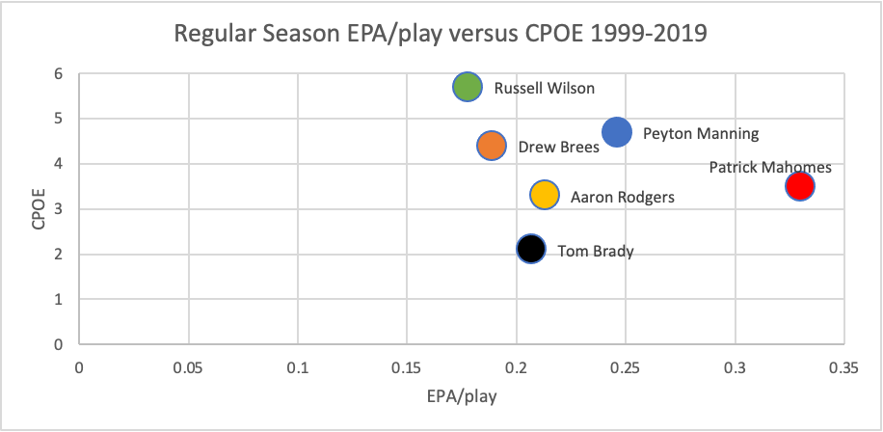

Slide 18
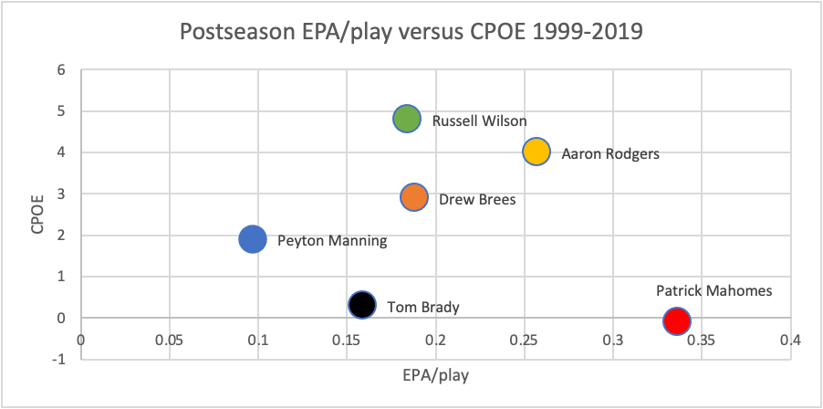

Slide 19
Analysis
Given the data, Tom Brady is outperformed by many of his peers. For the “greatest of all time,” he’s outperformed in Quarterback accuracy and efficiency by other Quarterbacks like Russell Wilson, Drew Brees, Aaron Rodgers, Patrick Mahomes, and Peyton Manning. Something crucial to the analysis is the narrative of Brady’s increased postseason play, however he is less accurate and less efficient in the postseason. His teams win despite his worse performance. Peyton Manning extremely exceeds him in regular season performance; however, Manning is a poor postseason player. Patrick Mahomes, while only being in the NFL for 3 years, outperforms Brady in both the regular and postseason. Aaron Rodgers and Drew Brees are also both more accurate in both seasons, while Rodgers has a better EPA/play in both and Brees has a better EPA/play in the postseason.

Slide 20
Conclusion
His poor performance against the Rams highlights the fact that Tom Brady is the most overrated player of all time. His Final stat line was: 30/54, 329 yards, 1 touchdown, 1 interception and a 72.2 passer rating. The game was competitive despite Tom Brady’s poor performance. While the Bucs defense performed not perfect, the Bucs lost because Tom Brady wasn’t good enough. If you take out a 2 30-yard offensive drives that led to touchdowns because the defense forced a fumble, Brady led the offense to 13 points. Not to mention a missed field goal by Matt Gay. The greatest quarterback of all time doesn’t do that. This was just an occurrence of the Buccaneers defense not performing well enough despite Brady. The case in plenty of Brady’s Super Bowl appearances is that he performs subpar and somehow his defense plays well enough to give him a fighting chance. His defense forced 2 fumbles to give Brady 2 opportunities to lead the team to touchdowns on 2 30-yard drives. He deserves that credit? No, the game was only close because of defensive performance, not because of Brady’s greatness. Brady played terrible and his defense played solidly. There were a few small cracks in the defense and the Rams won and took advantage of Brady’s poor performance. This is how Brady normally plays, but his team didn’t play well enough in spite of him. His team even gave him a fighting chance (one he didn’t deserve) but he still lost. Which just highlights his career as one of the most overrated athletes of all time and struggles to win when his defense doesn’t perform impeccably. People attribute Brady being good because of how his team performs. Tom Brady’s defense let him down with 42 seconds to go in the game. That felt so amazing to see as a fan because it was one of the first times that Tom Brady lost because of his teammates let him down. The motto of his career has been that he’s so good because of his teams and he loses the one time his team has a few cracks. The one time his defense messes up and plays not perfect he loses; it’s vindicating to see. That is just something that hasn’t happened to him in his career.

Slide 21
Sources
Steven Vu. (2015, Fall). The Era of Analytics in the NFL: Application of Modern Portfolio Theory. California State University, Long Beach. https://scholarworks.calstate.edu/downloads/z603qz23h
EPA/play and CPOE data found on https://rbsdm.com/stats/
Dave Archibald. (October 25, 2019). Glossary Entry: Expected Points Added. Inside the Pylon. http://insidethepylon.com/football-101/glossary-football-101/2019/10/25/glossary-entry-expected-points-added/
Joey DiCresce. (October 19, 2021). CPOE Explained. The 33rd Team. https://www.the33rdteam.com/cpoe-explained/
Unknown. (n.d.). Tom Brady. Pro Football Reference. https://www.pro-football-reference.com/players/B/BradTo00.htm
Unknown. (n.d.). Rams vs. Buccaneers – Game Summary – January 23, 2022 - ESPN. ESPN. https://www.espn.com/nfl/game/_/gameId/401326634
Unknown. (n.d.). 2019 Tampa Bay Buccaneers Statistics & Players. Pro Football Reference. https://www.pro-football-reference.com/teams/tam/2019.htm
Unknown. (n.d.). 2020 Tampa Bay Buccaneers Statistics & Players. Pro Football Reference. https://www.pro-football-reference.com/teams/tam/2020.htm
Unknown. (n.d.). 2019 New England Patriots Statistics & Players. Pro Football Reference. https://www.pro-football-reference.com/teams/nwe/2019.htm
Unknown. (n.d.). 2021 New England Patriots Statistics & Players. Pro Football Reference. https://www.pro-football-reference.com/teams/nwe/2021.htm

